Slide 1
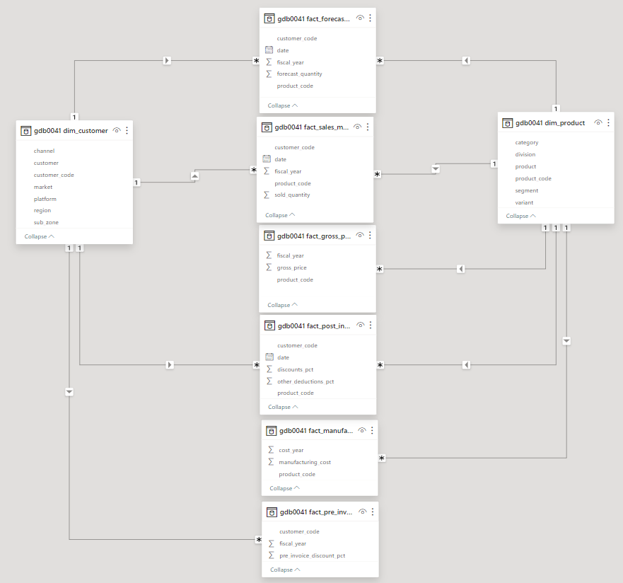
AtliQ Hardware is a budding computer hardware and peripherals selling company, expanding business in LATAM but facing loses due decisions based only on intuition from previous experiences, it’s moulding into a data driven company following are the business questions from product owner which has to be answered wrt data
meta data:

Slide 2
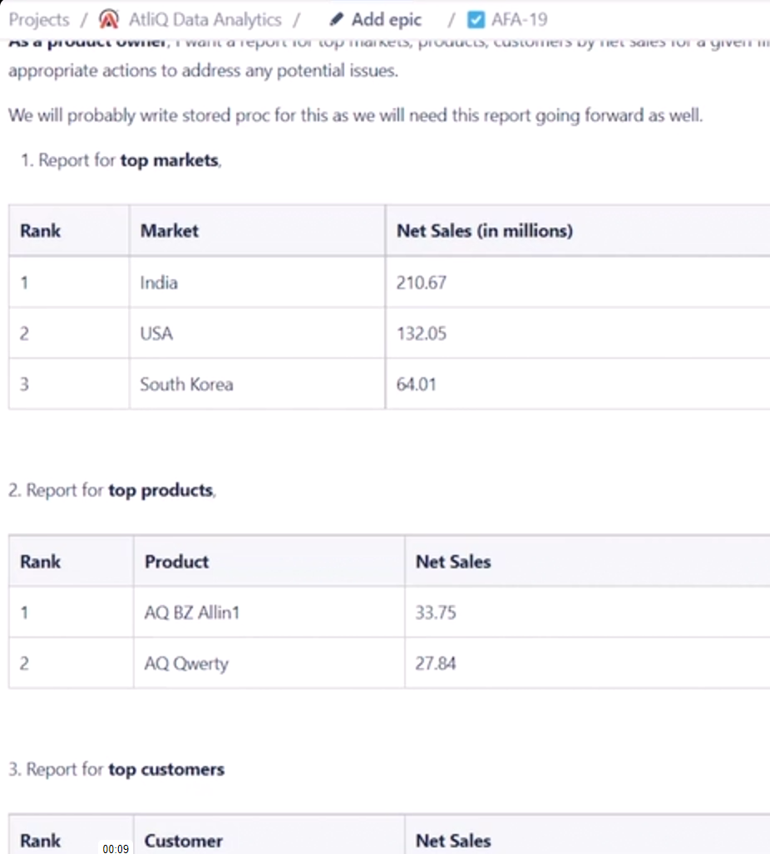
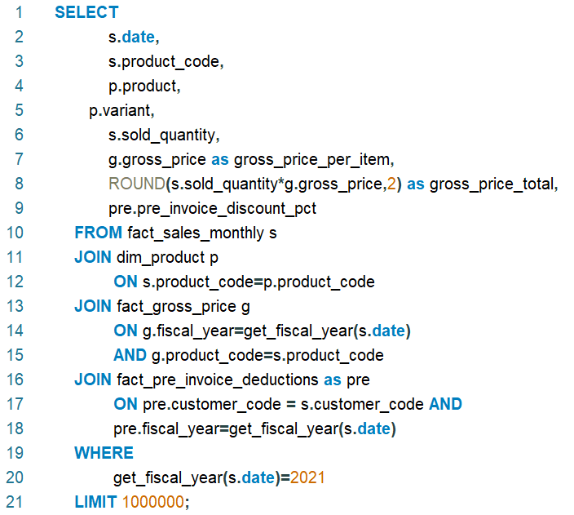
Top Customers, Products and Markets:
date | product_code | product | variant | sold_quantity | gross_price_per_item | gross_price_total | pre_invoice_discount_pct
01-09-2020 | A0118150101 | AQ Dracula HDD â€“ 3.5 Inch SATA 6 Gb/s 5400 RPM 256 MB Cache | Standard | 248 | 19.0573 | 4726.21 | 0.0703
01-09-2020 | A0118150101 | AQ Dracula HDD â€“ 3.5 Inch SATA 6 Gb/s 5400 RPM 256 MB Cache | Standard | 240 | 19.0573 | 4573.75 | 0.2061
01-09-2020 | A0118150101 | AQ Dracula HDD â€“ 3.5 Inch SATA 6 Gb/s 5400 RPM 256 MB Cache | Standard | 31 | 19.0573 | 590.78 | 0.0974
01-09-2020 | A0118150101 | AQ Dracula HDD â€“ 3.5 Inch SATA 6 Gb/s 5400 RPM 256 MB Cache | Standard | 37 | 19.0573 | 705.12 | 0.2065
01-09-2020 | A0118150101 | AQ Dracula HDD â€“ 3.5 Inch SATA 6 Gb/s 5400 RPM 256 MB Cache | Standard | 7 | 19.0573 | 133.4 | 0.1068
01-09-2020 | A0118150101 | AQ Dracula HDD â€“ 3.5 Inch SATA 6 Gb/s 5400 RPM 256 MB Cache | Standard | 12 | 19.0573 | 228.69 | 0.2612
The Query returned around 0.6M rows and the duration was 0.015 sec, fetch 7.922 sec.

Slide 3
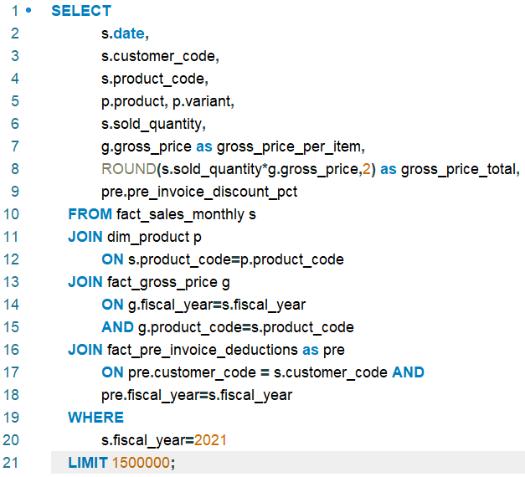
The root cause was the function for calculating the fiscal year has to run multiple times (Literally every row) and hence the performance has been optimized by introducing a separate dim_date table with fiscal dates and calendar date and joining the table with the fact table but it further can be optimised by adding the fiscal year column directly under the fact table.

Slide 4
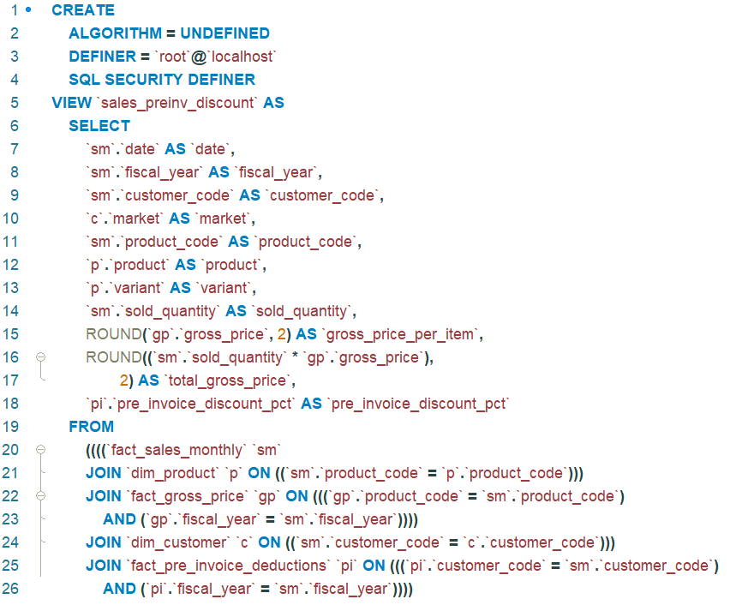
Creating a sales pre invoice discount level view (a virtual table In which the computation happens at run time everytime the query executes) for future use cases and to avoid multiple cte’s and join’s.

Slide 5
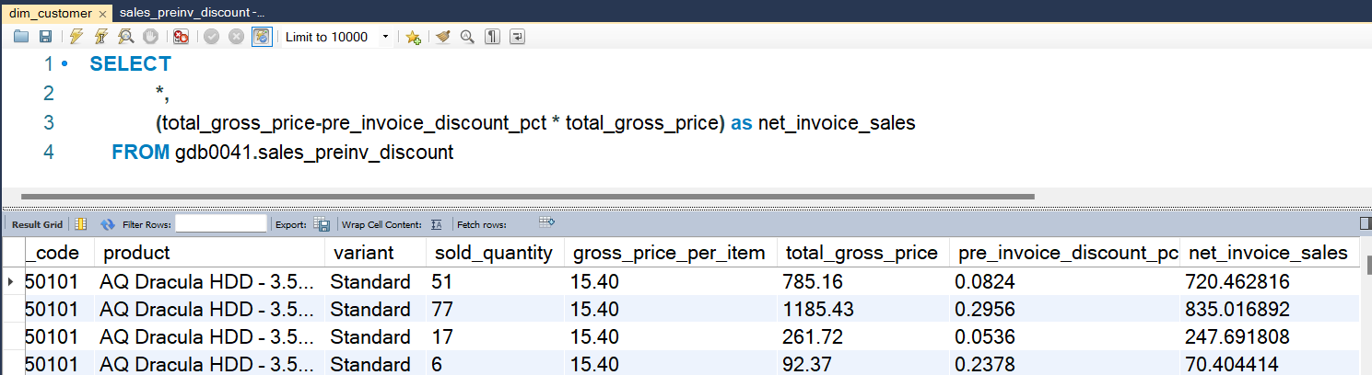
This is how we can get the net invoice sales using the pre invoice discount view and the previous view can be part of the query for next view

Slide 6
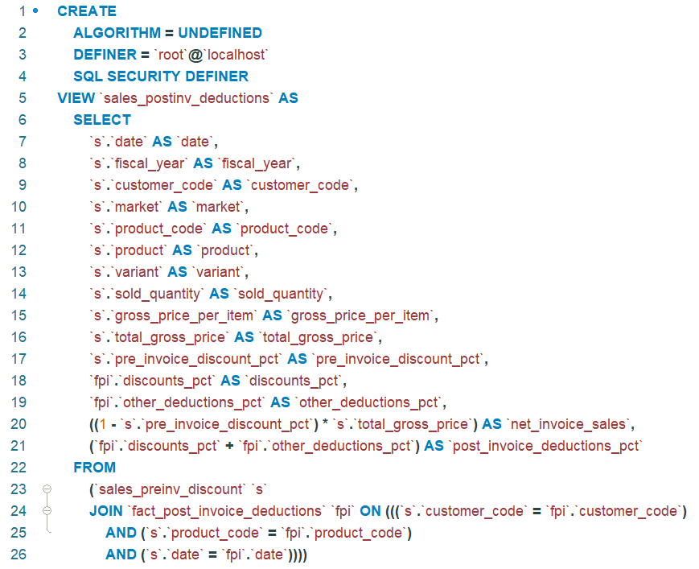
Creating view for post invoice deductions
date | fiscal_year | customer_code | market | product_code | product | variant | sold_quantity | gross_price_per_item | total_gross_price | pre_invoice_discount_pct | discounts_pct | other_deductions_pct | net_invoice_sales | post_invoice_deductions_pct
01-09-2017 | 2018 | 70002017 | India | A0118150101 | AQ Dracula HDD â€“ 3.5 Inch SATA 6 Gb/s 5400 RPM 256 MB Cache | Standard | 51 | 15.4 | 785.16 | 0.0824 | 0.266 | 0.0719 | 720.462816 | 0.3379
01-09-2017 | 2018 | 70002018 | India | A0118150101 | AQ Dracula HDD â€“ 3.5 Inch SATA 6 Gb/s 5400 RPM 256 MB Cache | Standard | 77 | 15.4 | 1185.43 | 0.2956 | 0.3189 | 0.0824 | 835.016892 | 0.4013
01-09-2017 | 2018 | 70003181 | Indonesia | A0118150101 | AQ Dracula HDD â€“ 3.5 Inch SATA 6 Gb/s 5400 RPM 256 MB Cache | Standard | 17 | 15.4 | 261.72 | 0.0536 | 0.2646 | 0.1106 | 247.691808 | 0.3752
01-09-2017 | 2018 | 70003182 | Indonesia | A0118150101 | AQ Dracula HDD â€“ 3.5 Inch SATA 6 Gb/s 5400 RPM 256 MB Cache | Standard | 6 | 15.4 | 92.37 | 0.2378 | 0.2447 | 0.0999 | 70.404414 | 0.3446
01-09-2017 | 2018 | 70006157 | Philiphines | A0118150101 | AQ Dracula HDD â€“ 3.5 Inch SATA 6 Gb/s 5400 RPM 256 MB Cache | Standard | 5 | 15.4 | 76.98 | 0.1057 | 0.2052 | 0.1013 | 68.843214 | 0.3065
01-09-2017 | 2018 | 70006158 | Philiphines | A0118150101 | AQ Dracula HDD â€“ 3.5 Inch SATA 6 Gb/s 5400 RPM 256 MB Cache | Standard | 7 | 15.4 | 107.77 | 0.1875 | 0.2567 | 0.102 | 87.563125 | 0.3587

Slide 7
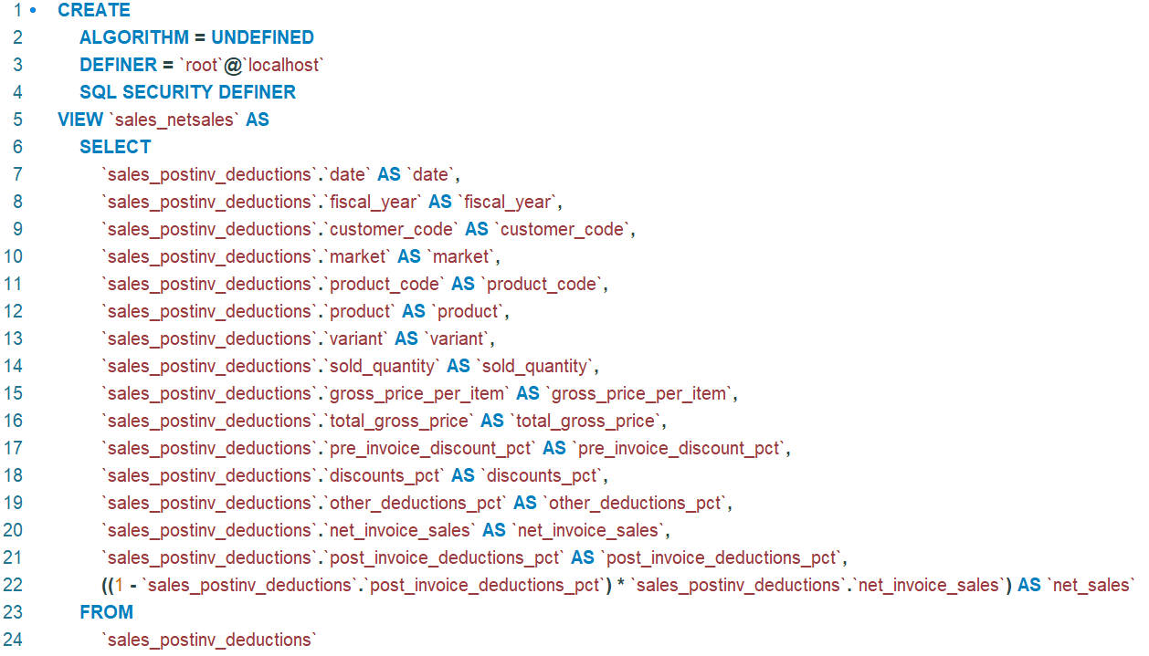
Creating view Net Sales
date | fiscal_year | customer_code | market | product_code | product | variant | sold_quantity | gross_price_per_item | total_gross_price | pre_invoice_discount_pct | discounts_pct | other_deductions_pct | net_invoice_sales | post_invoice_deductions_pct | net_sales
01-09-2017 | 2018 | 70002017 | India | A0118150101 | AQ Dracula HDD â€“ 3.5 Inch SATA 6 Gb/s 5400 RPM 256 MB Cache | Standard | 51 | 15.4 | 785.16 | 0.0824 | 0.266 | 0.0719 | 720.462816 | 0.3379 | 477.0184305
01-09-2017 | 2018 | 70002018 | India | A0118150101 | AQ Dracula HDD â€“ 3.5 Inch SATA 6 Gb/s 5400 RPM 256 MB Cache | Standard | 77 | 15.4 | 1185.43 | 0.2956 | 0.3189 | 0.0824 | 835.016892 | 0.4013 | 499.9246132
01-09-2017 | 2018 | 70003181 | Indonesia | A0118150101 | AQ Dracula HDD â€“ 3.5 Inch SATA 6 Gb/s 5400 RPM 256 MB Cache | Standard | 17 | 15.4 | 261.72 | 0.0536 | 0.2646 | 0.1106 | 247.691808 | 0.3752 | 154.7578416
01-09-2017 | 2018 | 70003182 | Indonesia | A0118150101 | AQ Dracula HDD â€“ 3.5 Inch SATA 6 Gb/s 5400 RPM 256 MB Cache | Standard | 6 | 15.4 | 92.37 | 0.2378 | 0.2447 | 0.0999 | 70.404414 | 0.3446 | 46.14305294
01-09-2017 | 2018 | 70006157 | Philiphines | A0118150101 | AQ Dracula HDD â€“ 3.5 Inch SATA 6 Gb/s 5400 RPM 256 MB Cache | Standard | 5 | 15.4 | 76.98 | 0.1057 | 0.2052 | 0.1013 | 68.843214 | 0.3065 | 47.74276891
01-09-2017 | 2018 | 70006158 | Philiphines | A0118150101 | AQ Dracula HDD â€“ 3.5 Inch SATA 6 Gb/s 5400 RPM 256 MB Cache | Standard | 7 | 15.4 | 107.77 | 0.1875 | 0.2567 | 0.102 | 87.563125 | 0.3587 | 56.15423206
01-09-2017 | 2018 | 70007198 | South Korea | A0118150101 | AQ Dracula HDD â€“ 3.5 Inch SATA 6 Gb/s 5400 RPM 256 MB Cache | Standard | 29 | 15.4 | 446.46 | 0.07 | 0.2386 | 0.0957 | 415.2078 | 0.3343 | 276.4038325
01-09-2017 | 2018 | 70007199 | South Korea | A0118150101 | AQ Dracula HDD â€“ 3.5 Inch SATA 6 Gb/s 5400 RPM 256 MB Cache | Standard | 34 | 15.4 | 523.44 | 0.2551 | 0.3219 | 0.0949 | 389.910456 | 0.4168 | 227.3957779

Slide 8

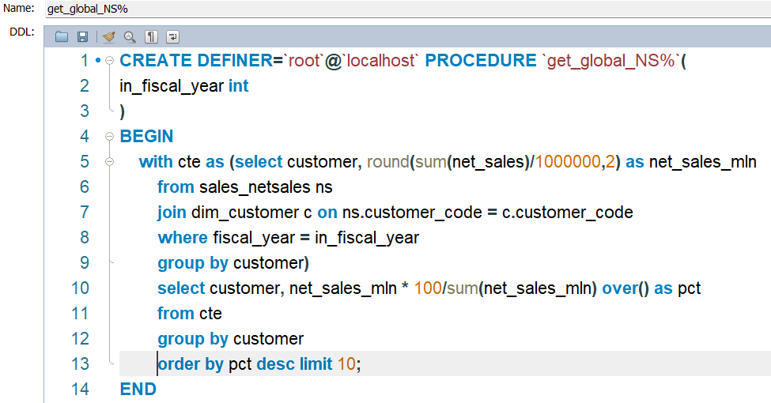
New Jira Task
Insights:
Recommendations:

Slide 9
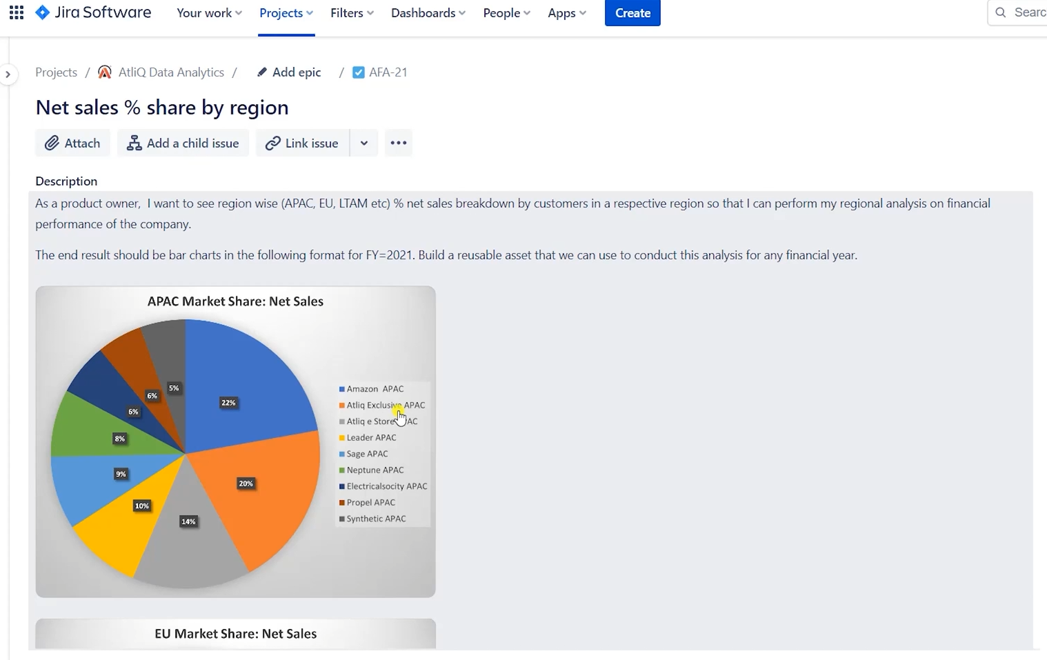

Slide 10
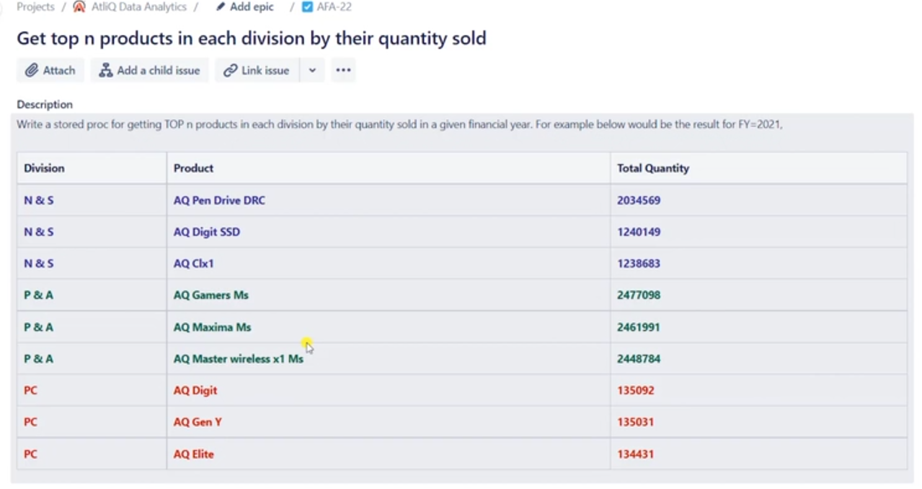
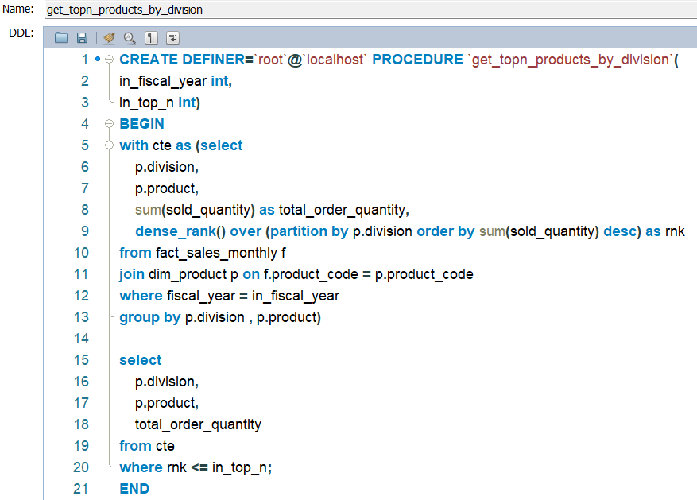
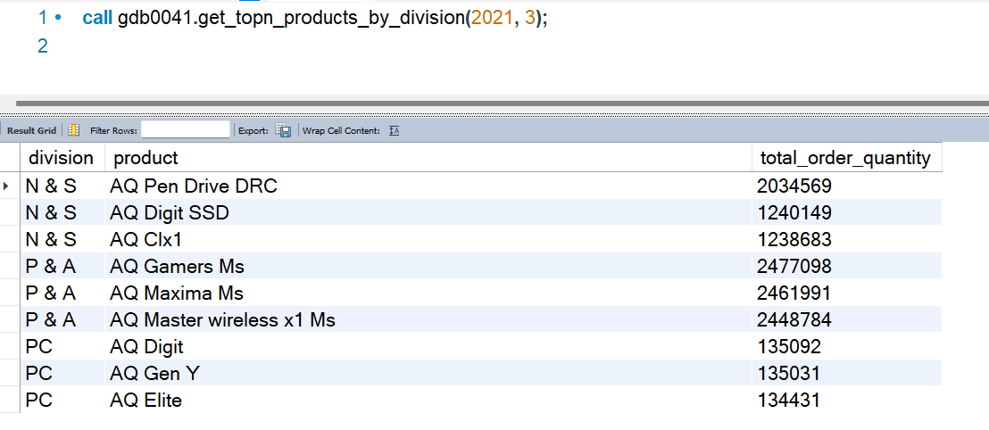

Slide 11
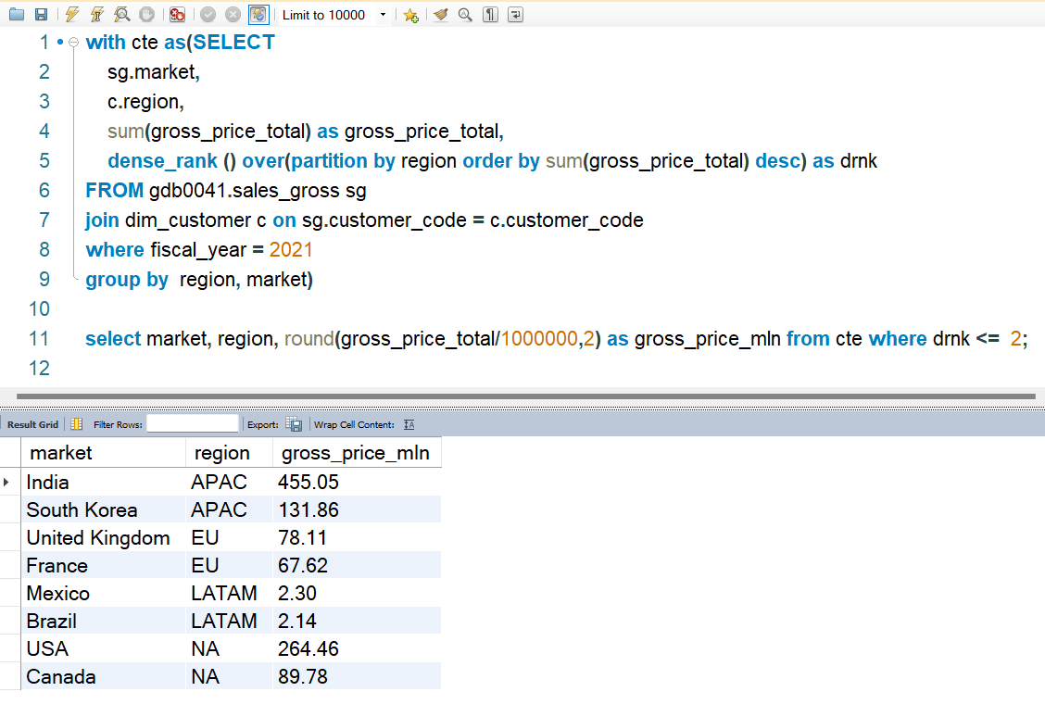
Retrieve the top 2 markets in every region by their gross sales amount in FY=2021

